Slide 1
Goal of today
Team Teample – ML (scenario 1)
GOAL: Team with best explanation of how the insights of the RAI metrics can be used, with actions, wins. Extra points if all available tools and metrics is analysed, and its meaning explained
Explain different metrics, what value & insights they brought you and your use case.
Point down ACTIONS how to improve the solution, to include more people, be more accuracte, etc.
Presentation tools: Powerpoint with screenshots & your insight analysis. (Answer the questions to the right)
Explore:
Q1) What value does these insights give you?
Q2) What feature impacts the prediction the most?
Q3) Is the dataset skewed, does it has imbalance, and if so what cohort/gender/age group is over/under represented?
Q4) What is the purpose & difference between RAI dashboard, and RAI scorecard? Is they meant for same stakeholders?
Do:
Create a new cohort, based on cohort with the most errors:
Explore again:
Q5) What value does these NEW insights give you?
Not needed:
You do not need to change data, and retrain the model, to see improvement. Even though that would be the “real scenario”.

Slide 2
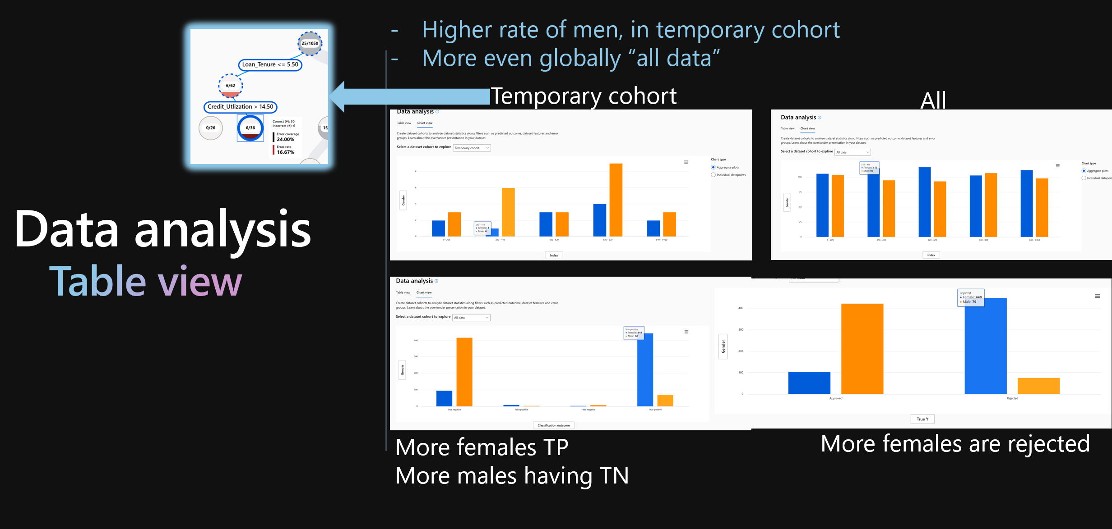
Q1 What value does these insights give you?
Example
(ML)
Insight A) More females are rejected generally, and more men have TN
Insight B) higher rate of men in my temporary cohort
Action: Add more data with men to fit the cohort

Slide 3
Goal of today
Team Teample – GenAI (scenario 2)
GOAL: Team with best explanation of how the insights of the RAI metrics can be used, with actions, wins. Extra points if all available tools and metrics is analysed, and its meaning explained
Explain different metrics, what value & insights they brought you and your use case.
Point down ACTIONS how to improve the solution, to include more people, be more accurate, etc.
Presentation tools: Powerpoint with screenshots & your insight analysis. (Answer the questions to the right)
Explore:
Q1) Single-index evaluation: Save the results, as screshots.
Q2) What metrics are low, and why is it low? How to improve it? Ellaborate on what actions to take?
Q3) How does changes in Temperature, Grounding data, Ground truth data impact the metrics? Try changing one at the time?
Q4) Find the performance metrics insights? Examplify Reqeuest VS Time to respond, for your OpenAI resource?
Q5) Auto evaluation: Find the hate_unfairness_evaluator and see how long (ms) this activity was running in your evaluation, and the value of hate_unfairness
Q6) Multi-index promptflow evaluation: Did the evaluation results differ from Single-index evaluation? In what way
Do:
Create both manual evaluation from AI Studio, and automatic evaluation from AI studio, and promptflow batch evaluation on ground truth data.
Not needed:
You do not need to finetune the model. You don’t need to do real-time monitoring (gold star of you did)

Slide 4
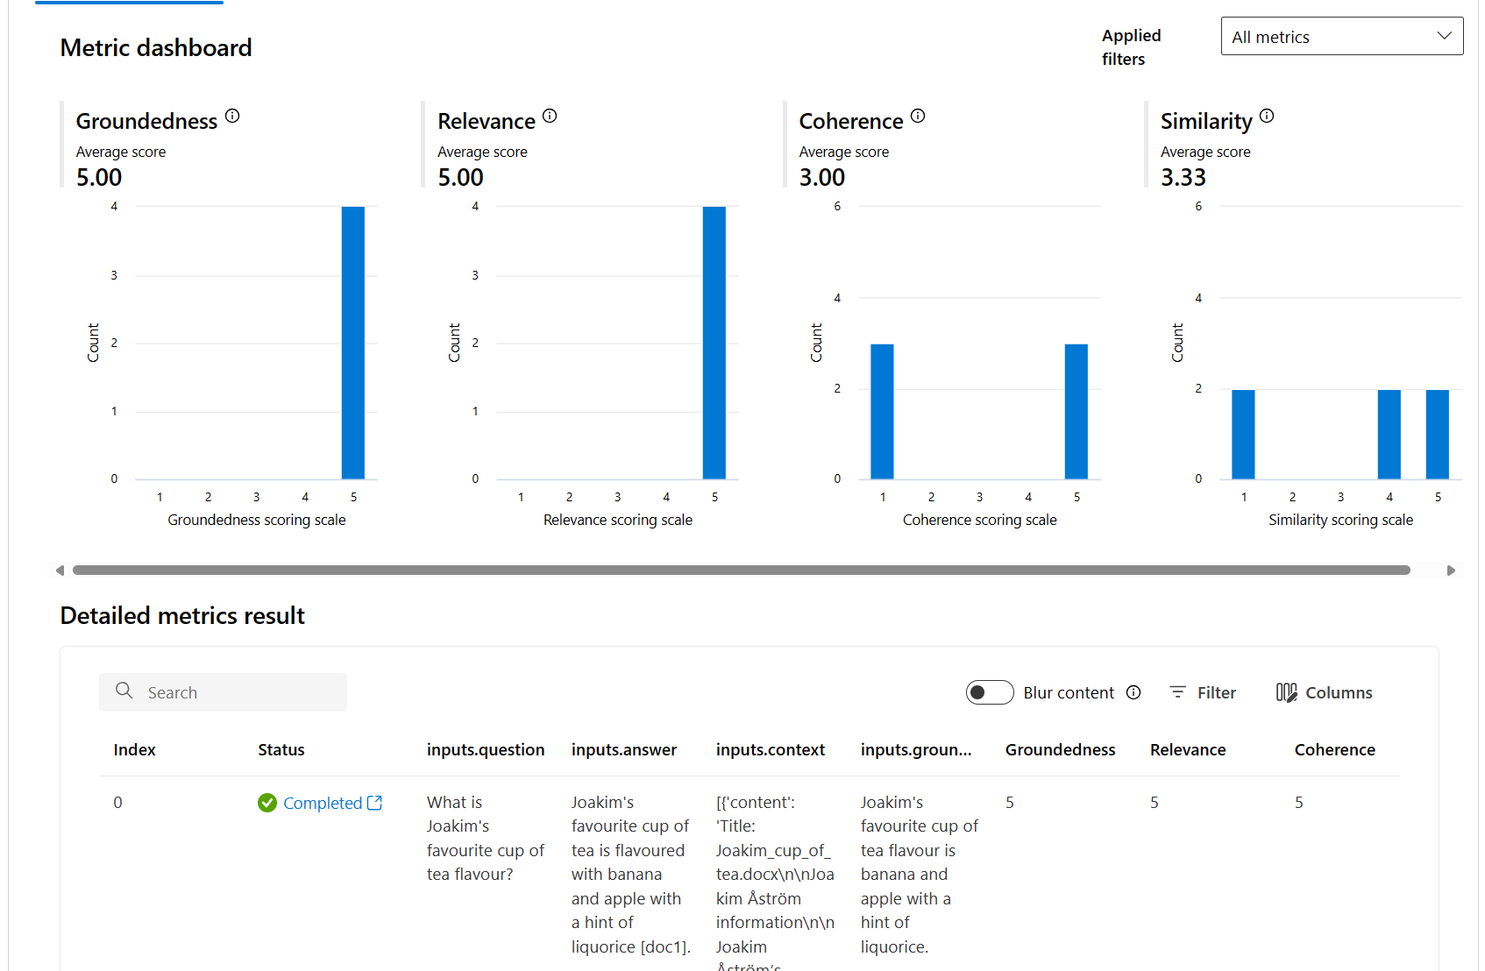


Q1, Q2:What value does these insights give you?
Example
(GenAI)
Insight A) Good groundednes in answers, and relevant answers
Insight B) Coherence and similarity to ground truth answers was low
Action 1: Try another retrieval approach: Vector VS Keyword VS Hybrid
Action 2: Try changing temperature
Action 3: Try adding more ground truth data

Slide 5
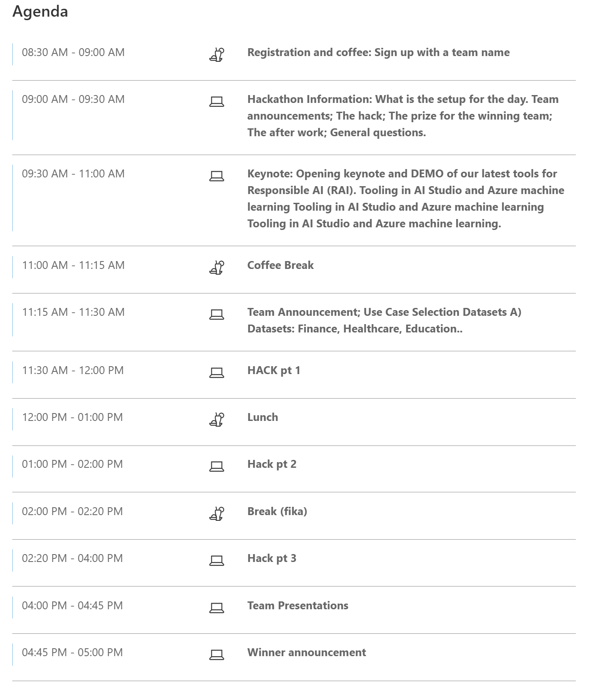
Agenda
You are here

Slide 6
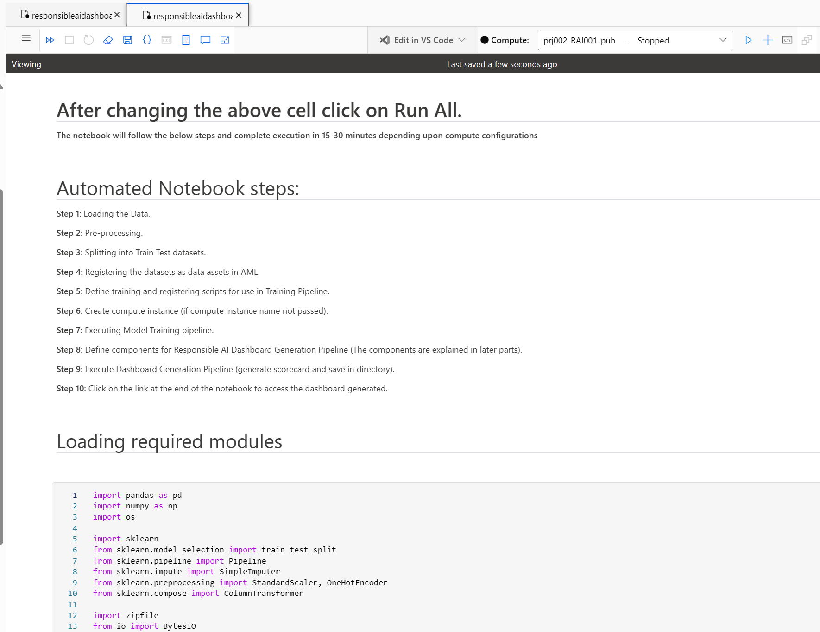
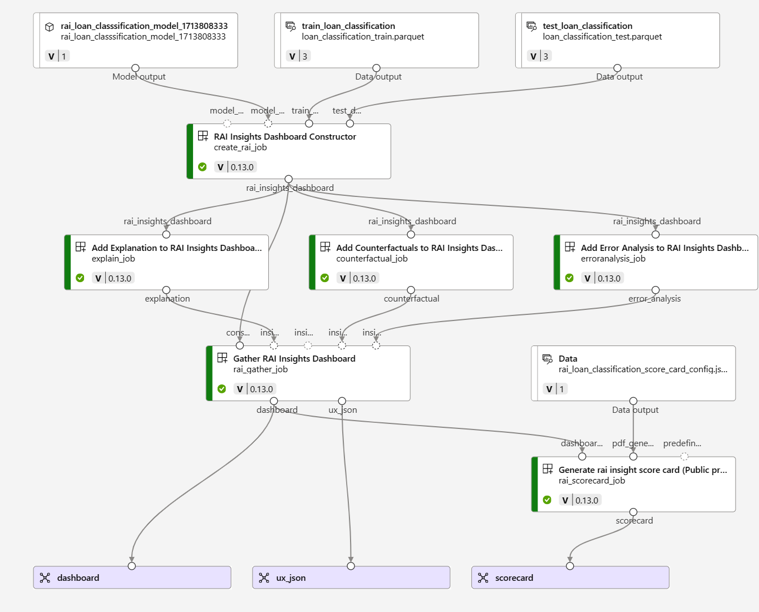
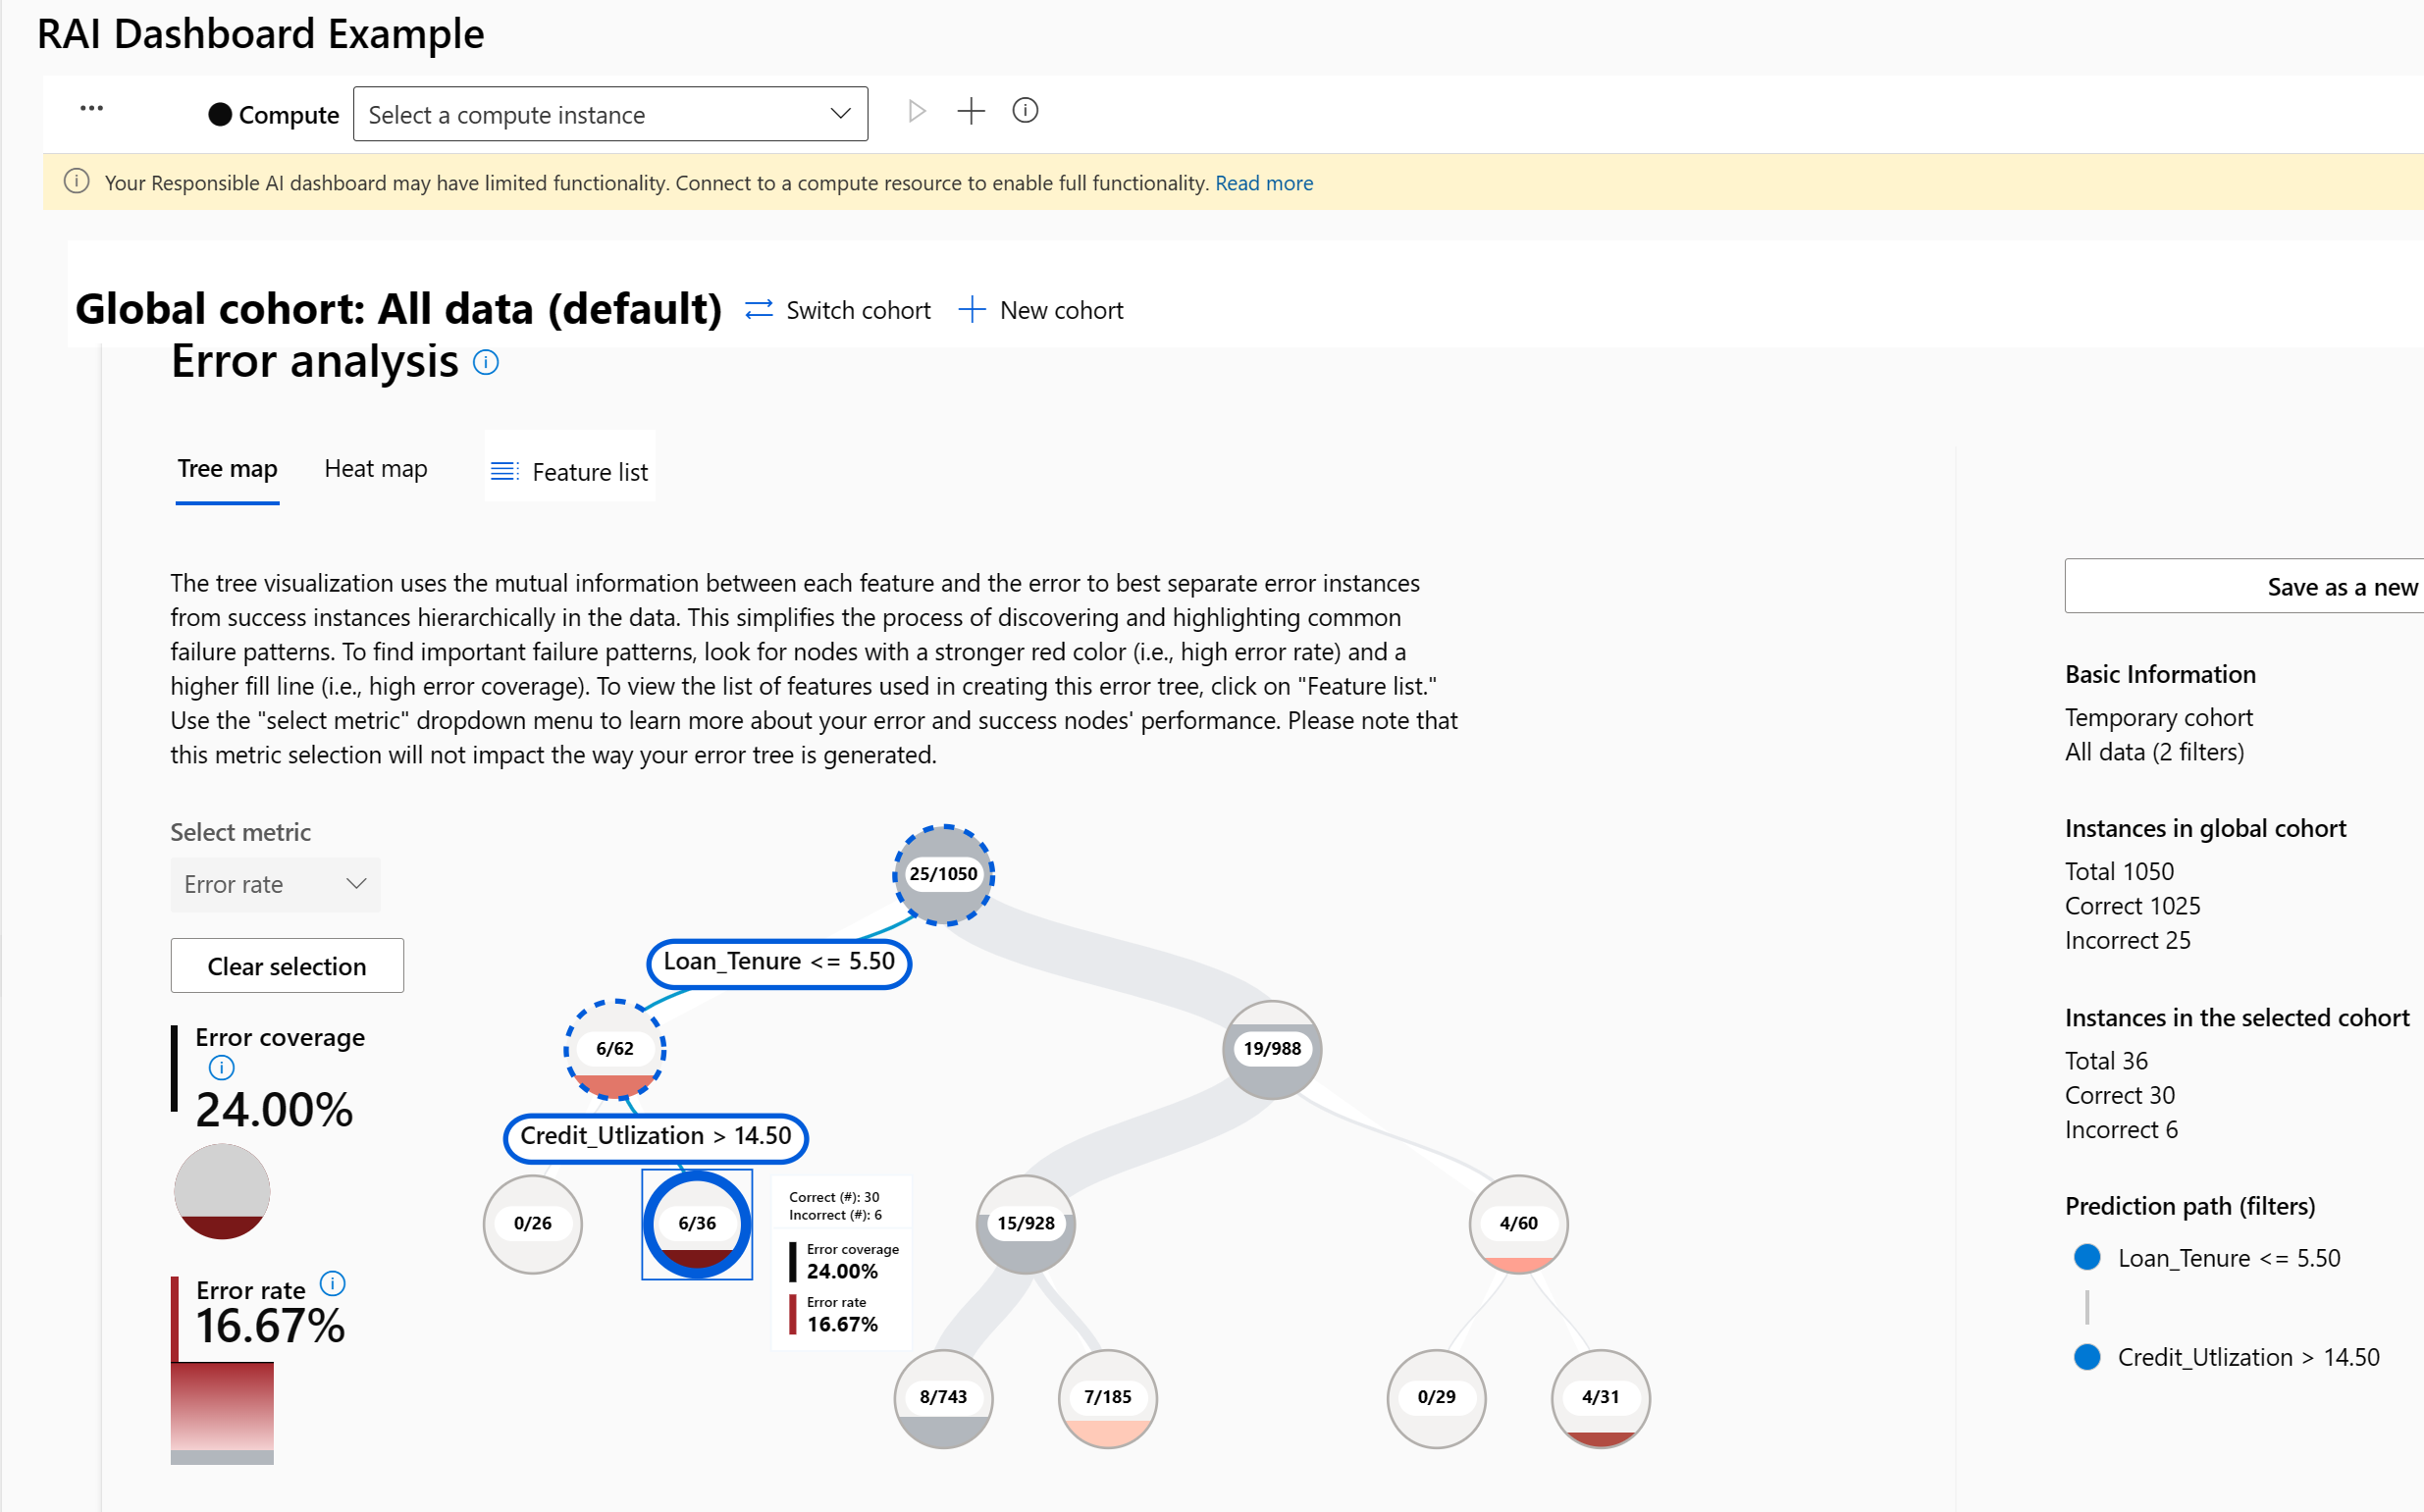
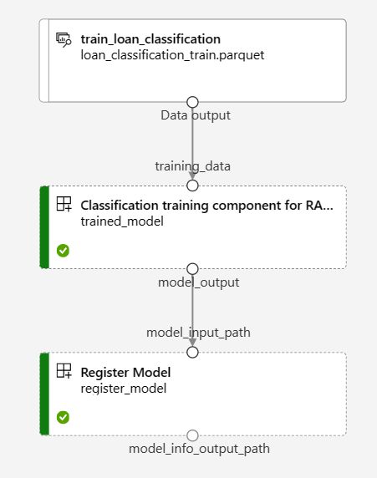

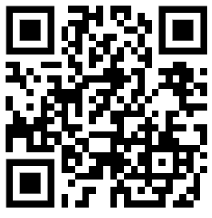
DEMO
Scenario 1: RAI Dashboard (ML)
Notebook
Train pipeline+
RAI Pipeline
Dashboard
Training
Dashboard
Go to GITHUB repo (Data, Instructions, Code)
https://github.com/jostrm/azure-rai-hax
Scenario 1
2. Follow instructions, e.g. run notebook that TRAINS model, and Generate the RAI dashboard
3. Use the RAI dashboard. Push all buttons, write down answers for the Q’s in the GITHUB instructions. E.g. Q’s like
Q1) What values does the Error analysis section bring you, where you can create temporary cohorts, or create new cohorts?
Q2) What values does the other section bring you?
Other representations of Error analysis, Counterfactuals analysis and what-if analysis, Feature importance, Fairness, Causal analysis (only regression supported),
https://github.com/jostrm/azure-rai-hax
Notes:
And Microsoft runs on trust. We are committed to security, privacy, and compliance across everything we do, and our approach to AI is no different.
Trust has been a fundamental promise we have built into the Microsoft Cloud since the very beginning.
Data is the fuel that powers AI technology – and you need to trust what your technology partners are doing with your data.
First, your data is your data. It is not our data. It is your data. That means it is yours to own and control. Your data to chose how you want to leverage and monetize.
Your data is not used to train or enrich the foundational AI models used by others without your permission, so you don’t have to worry about anyone other than your organization benefiting from AI that is trained on your data.
And your data and AI models are protected at every step by the most comprehensive enterprise compliance and security controls in the industry.

Slide 7
Global cohort
Scenario 1: RAI Dashboard (ML)
Error analysis
Notes:
And Microsoft runs on trust. We are committed to security, privacy, and compliance across everything we do, and our approach to AI is no different.
Trust has been a fundamental promise we have built into the Microsoft Cloud since the very beginning.
Data is the fuel that powers AI technology – and you need to trust what your technology partners are doing with your data.
First, your data is your data. It is not our data. It is your data. That means it is yours to own and control. Your data to chose how you want to leverage and monetize.
Your data is not used to train or enrich the foundational AI models used by others without your permission, so you don’t have to worry about anyone other than your organization benefiting from AI that is trained on your data.
And your data and AI models are protected at every step by the most comprehensive enterprise compliance and security controls in the industry.

Slide 8
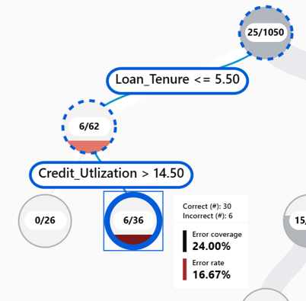
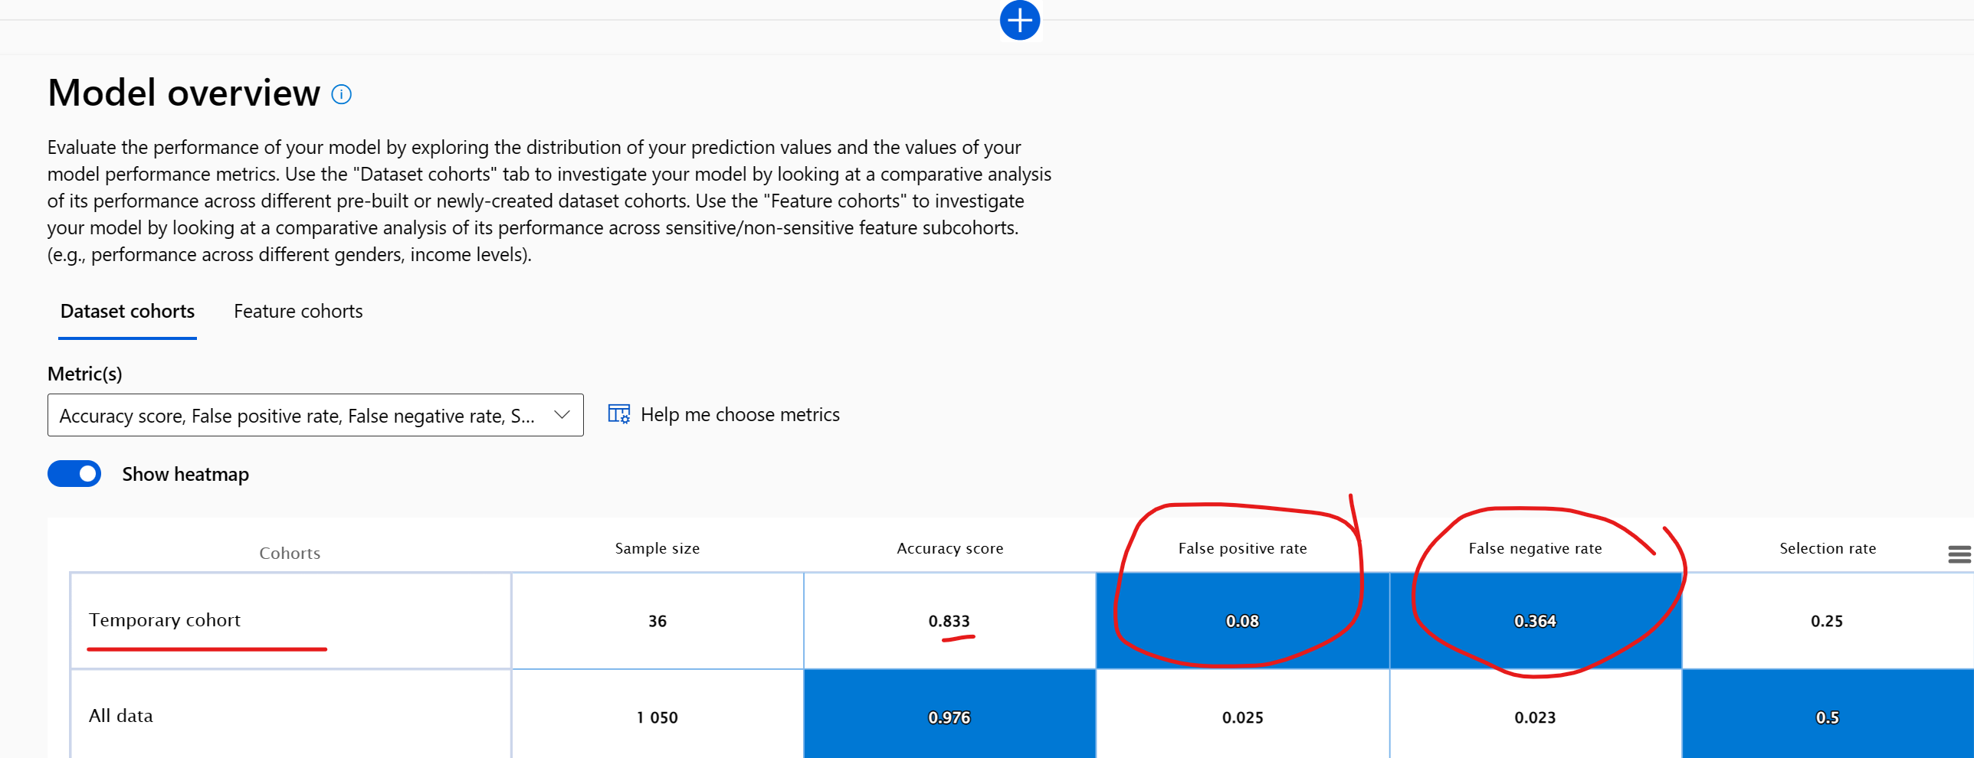
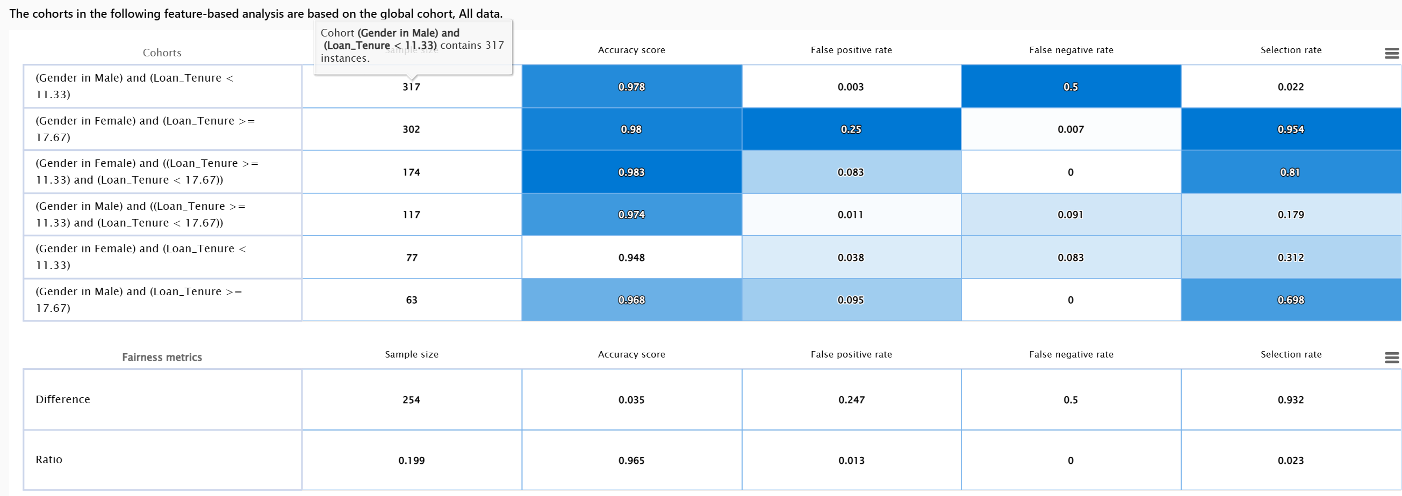
Model overview
Scenario 1: RAI Dashboard (ML)
Temporary cohort
Dataset cohorts
Error analysis
Feature cohorts: Gender, Loan_Tenure
Notes:
And Microsoft runs on trust. We are committed to security, privacy, and compliance across everything we do, and our approach to AI is no different.
Trust has been a fundamental promise we have built into the Microsoft Cloud since the very beginning.
Data is the fuel that powers AI technology – and you need to trust what your technology partners are doing with your data.
First, your data is your data. It is not our data. It is your data. That means it is yours to own and control. Your data to chose how you want to leverage and monetize.
Your data is not used to train or enrich the foundational AI models used by others without your permission, so you don’t have to worry about anyone other than your organization benefiting from AI that is trained on your data.
And your data and AI models are protected at every step by the most comprehensive enterprise compliance and security controls in the industry.

Slide 9
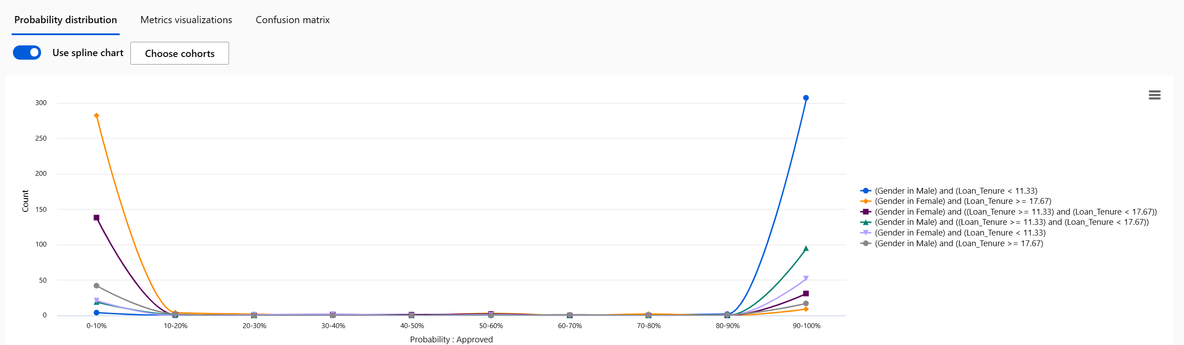
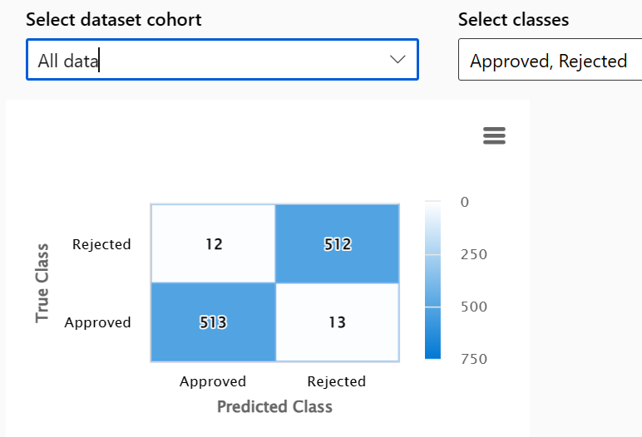
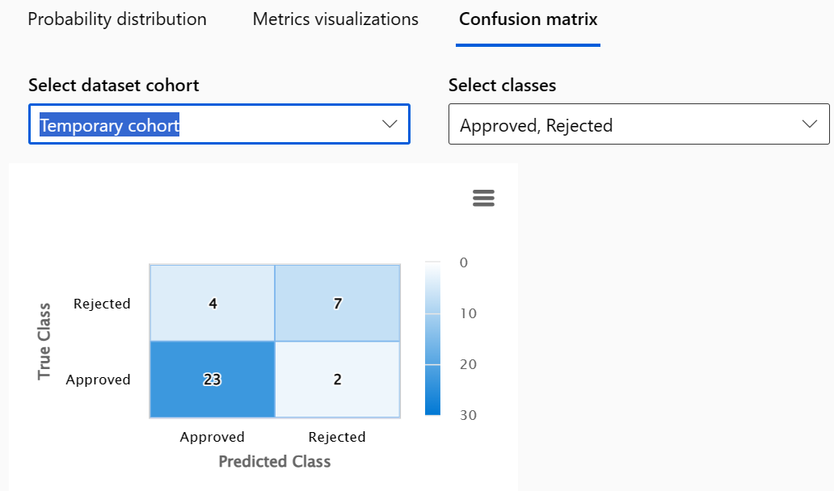
Model overview
Scenario 1: RAI Dashboard (ML)
Men who repay loan quickly, has a high chance to get approved
Women, with slow repayment history, low chance.
Probability distribution
Notes:
And Microsoft runs on trust. We are committed to security, privacy, and compliance across everything we do, and our approach to AI is no different.
Trust has been a fundamental promise we have built into the Microsoft Cloud since the very beginning.
Data is the fuel that powers AI technology – and you need to trust what your technology partners are doing with your data.
First, your data is your data. It is not our data. It is your data. That means it is yours to own and control. Your data to chose how you want to leverage and monetize.
Your data is not used to train or enrich the foundational AI models used by others without your permission, so you don’t have to worry about anyone other than your organization benefiting from AI that is trained on your data.
And your data and AI models are protected at every step by the most comprehensive enterprise compliance and security controls in the industry.

Slide 10
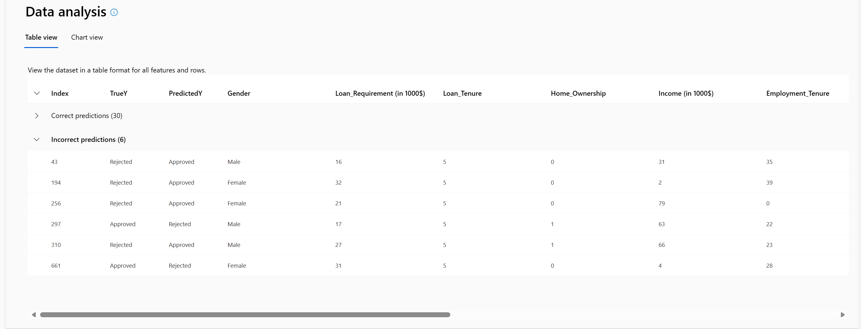
Data analysis
Scenario 1: RAI Dashboard (ML)
6 incorrect predictions of 36
Table view
Notes:
And Microsoft runs on trust. We are committed to security, privacy, and compliance across everything we do, and our approach to AI is no different.
Trust has been a fundamental promise we have built into the Microsoft Cloud since the very beginning.
Data is the fuel that powers AI technology – and you need to trust what your technology partners are doing with your data.
First, your data is your data. It is not our data. It is your data. That means it is yours to own and control. Your data to chose how you want to leverage and monetize.
Your data is not used to train or enrich the foundational AI models used by others without your permission, so you don’t have to worry about anyone other than your organization benefiting from AI that is trained on your data.
And your data and AI models are protected at every step by the most comprehensive enterprise compliance and security controls in the industry.

Slide 11
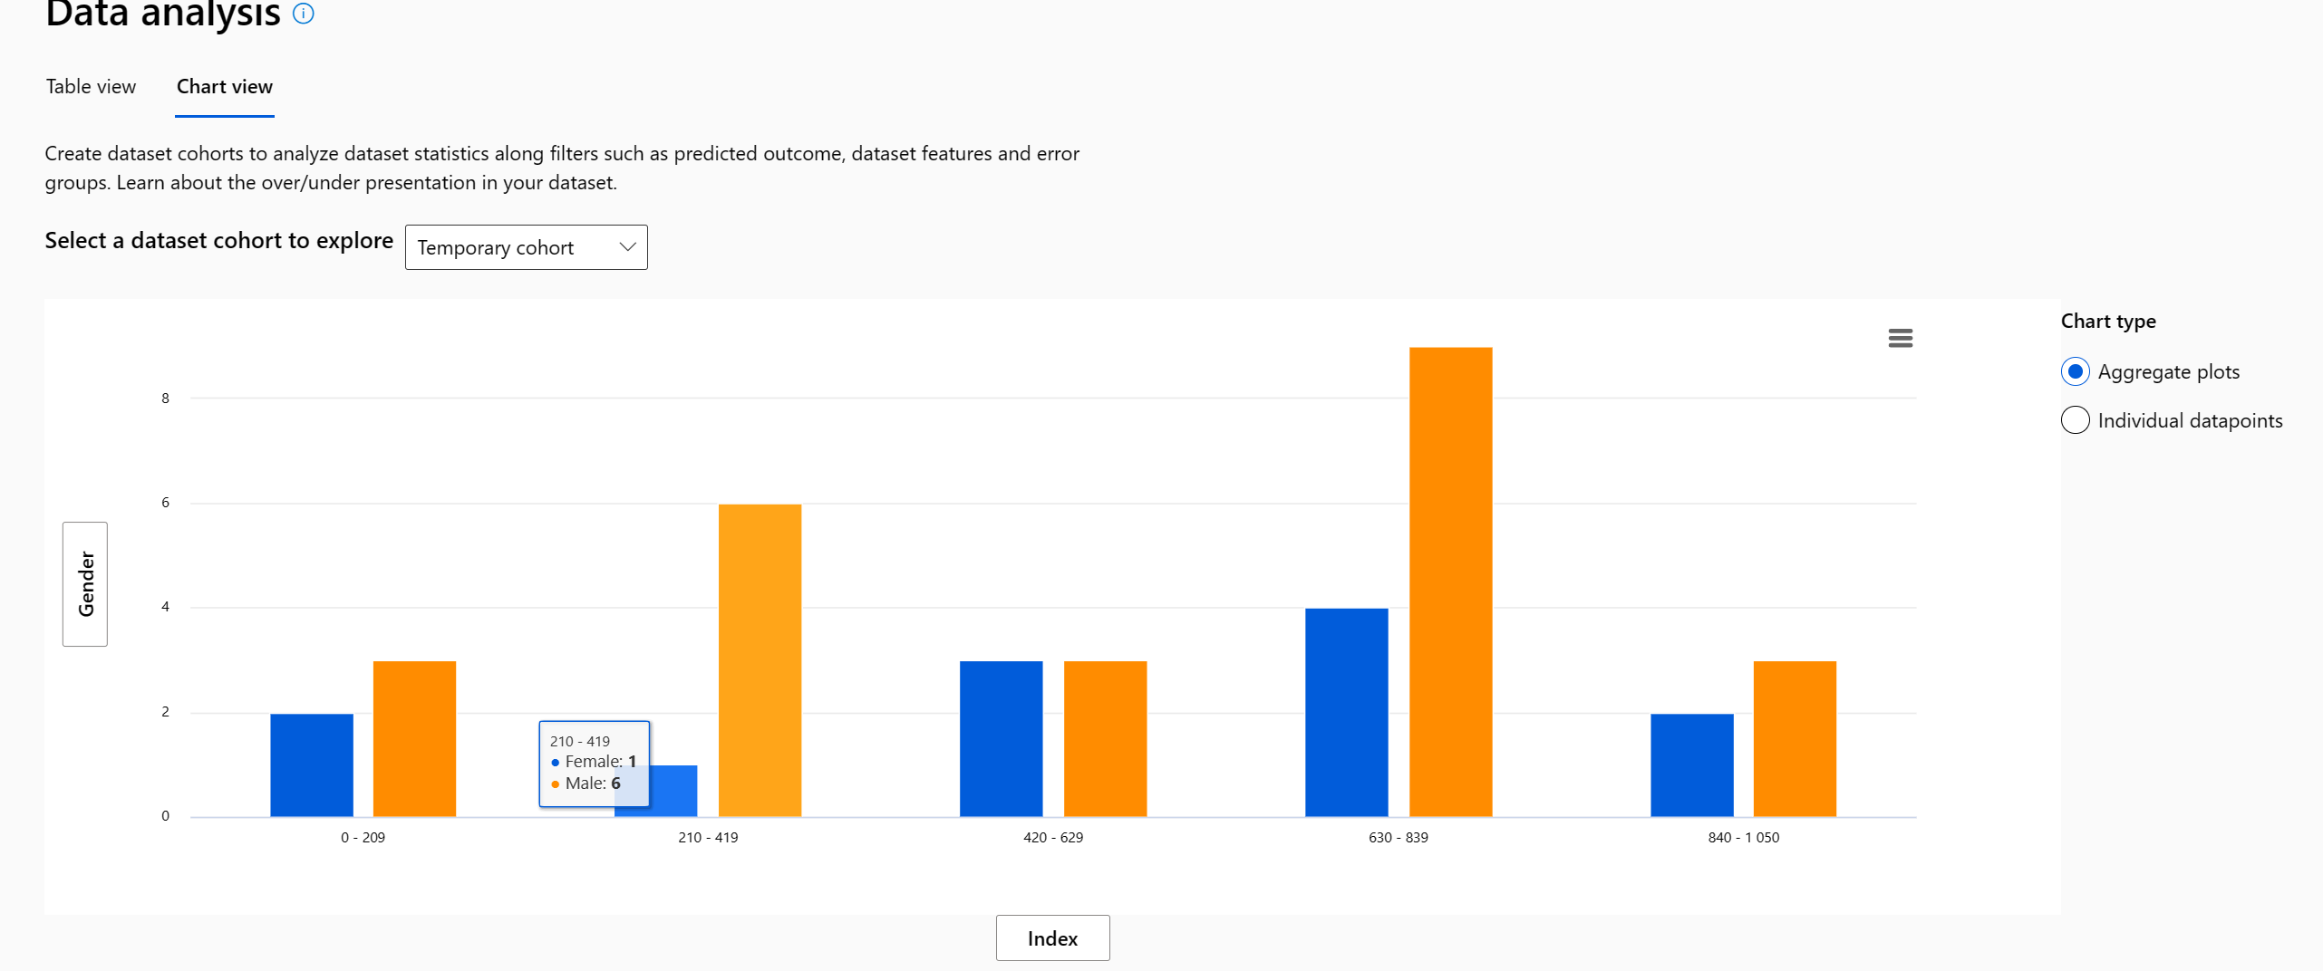
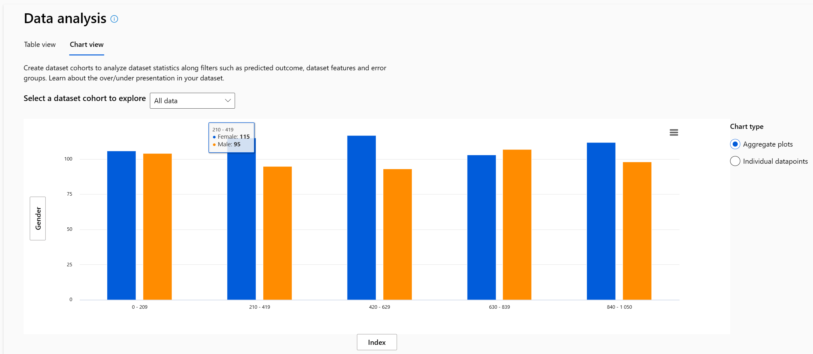
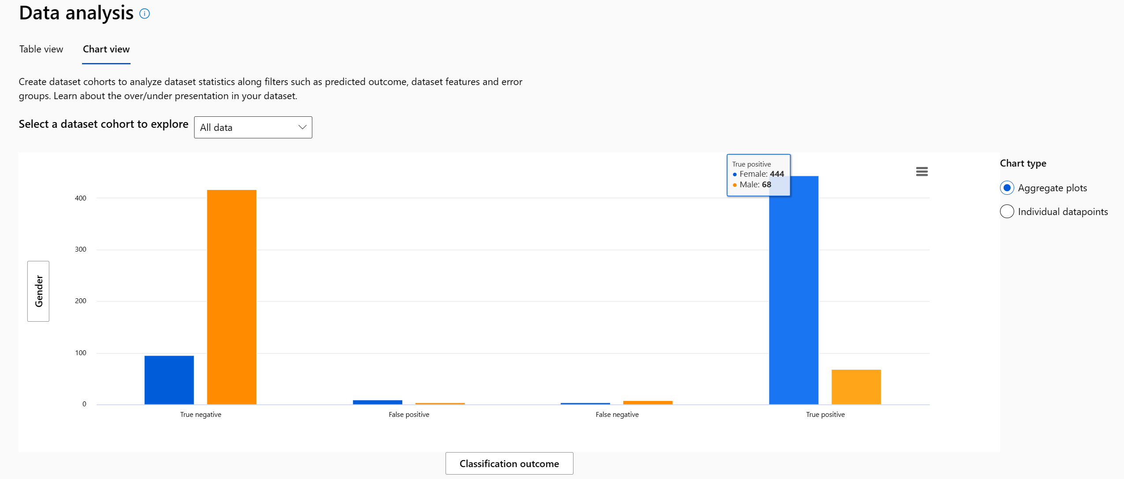
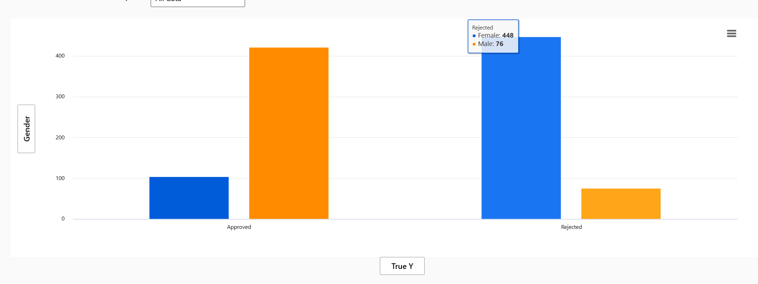
Data analysis
Scenario 1: RAI Dashboard (ML)
Higher rate of men, in temporary cohort
More even globally “all data”
Temporary cohort
All
Table view
More females TP
More males having TN
More females are rejected
Notes:
And Microsoft runs on trust. We are committed to security, privacy, and compliance across everything we do, and our approach to AI is no different.
Trust has been a fundamental promise we have built into the Microsoft Cloud since the very beginning.
Data is the fuel that powers AI technology – and you need to trust what your technology partners are doing with your data.
First, your data is your data. It is not our data. It is your data. That means it is yours to own and control. Your data to chose how you want to leverage and monetize.
Your data is not used to train or enrich the foundational AI models used by others without your permission, so you don’t have to worry about anyone other than your organization benefiting from AI that is trained on your data.
And your data and AI models are protected at every step by the most comprehensive enterprise compliance and security controls in the industry.

Slide 12
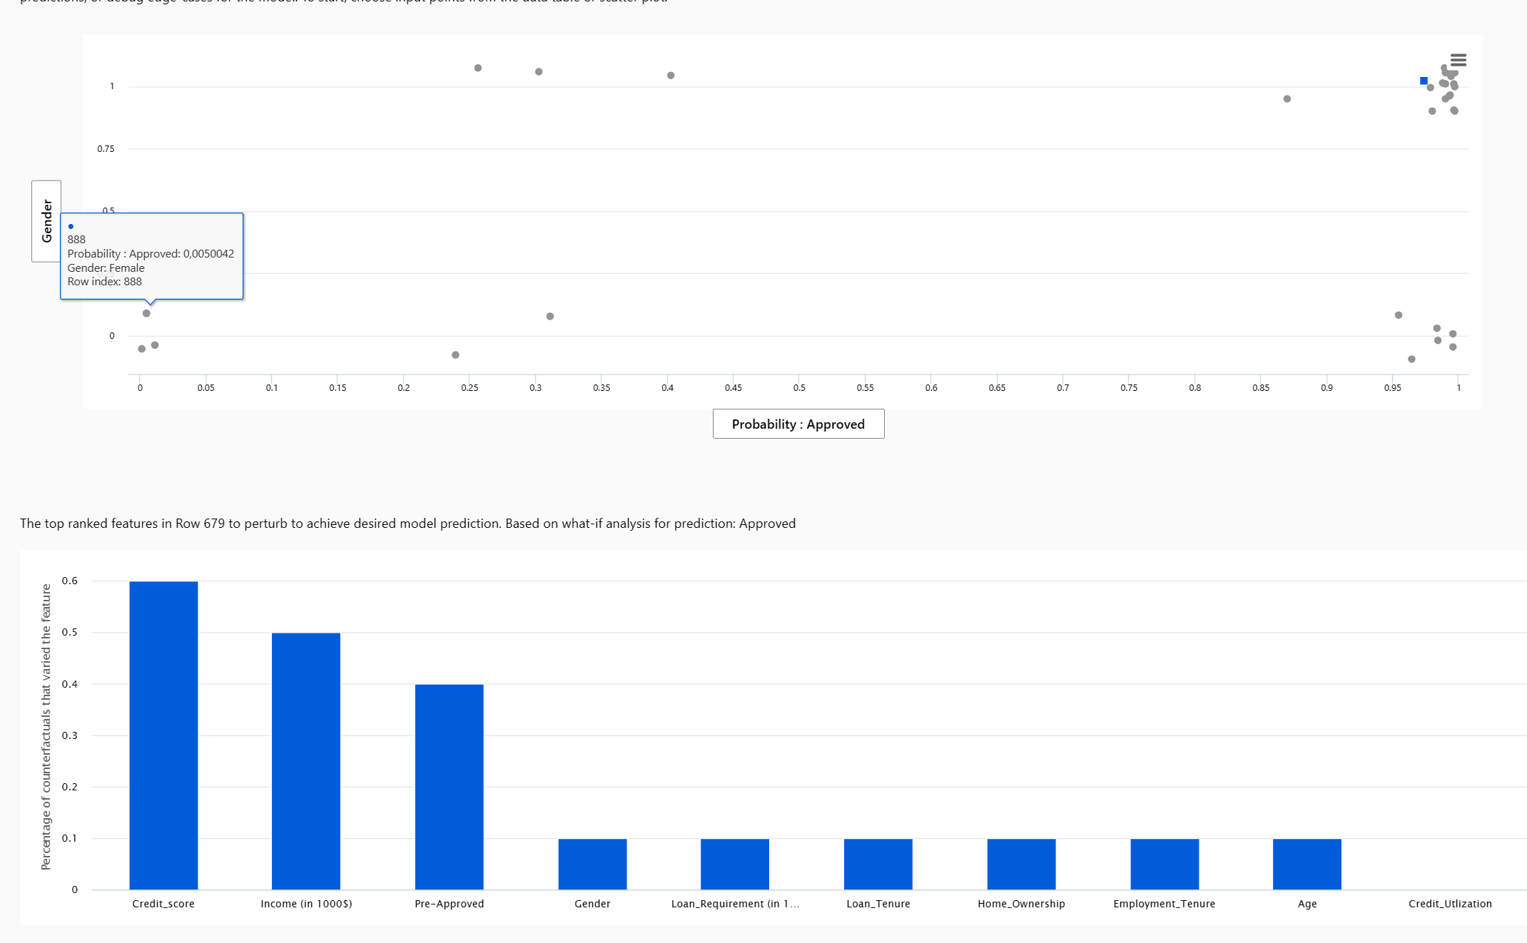
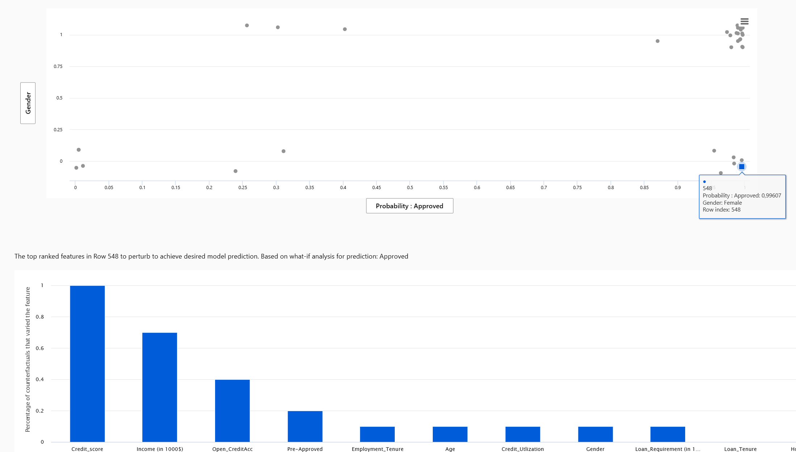

Counterfactual
Scenario 1: RAI Dashboard (ML)
Approved, men
What-if allows you to perturb features for any input and observe how the model's prediction changes
What-if analysis
You can perturb features manually or specify the desired prediction (e.g., class label for a classifier) to see a list of closest data points to the original input that would lead to the desired prediction.
Notes:
And Microsoft runs on trust. We are committed to security, privacy, and compliance across everything we do, and our approach to AI is no different.
Trust has been a fundamental promise we have built into the Microsoft Cloud since the very beginning.
Data is the fuel that powers AI technology – and you need to trust what your technology partners are doing with your data.
First, your data is your data. It is not our data. It is your data. That means it is yours to own and control. Your data to chose how you want to leverage and monetize.
Your data is not used to train or enrich the foundational AI models used by others without your permission, so you don’t have to worry about anyone other than your organization benefiting from AI that is trained on your data.
And your data and AI models are protected at every step by the most comprehensive enterprise compliance and security controls in the industry.

Slide 13
Causal analysis
Scenario 1: RAI Dashboard (ML)
“optimization”
Selecting any individual data point, perturbing its treatment features, and seeing the expected causal outcome of causal what-if is supported (only for regression machine learning scenarios).
Notes:
And Microsoft runs on trust. We are committed to security, privacy, and compliance across everything we do, and our approach to AI is no different.
Trust has been a fundamental promise we have built into the Microsoft Cloud since the very beginning.
Data is the fuel that powers AI technology – and you need to trust what your technology partners are doing with your data.
First, your data is your data. It is not our data. It is your data. That means it is yours to own and control. Your data to chose how you want to leverage and monetize.
Your data is not used to train or enrich the foundational AI models used by others without your permission, so you don’t have to worry about anyone other than your organization benefiting from AI that is trained on your data.
And your data and AI models are protected at every step by the most comprehensive enterprise compliance and security controls in the industry.

Slide 14
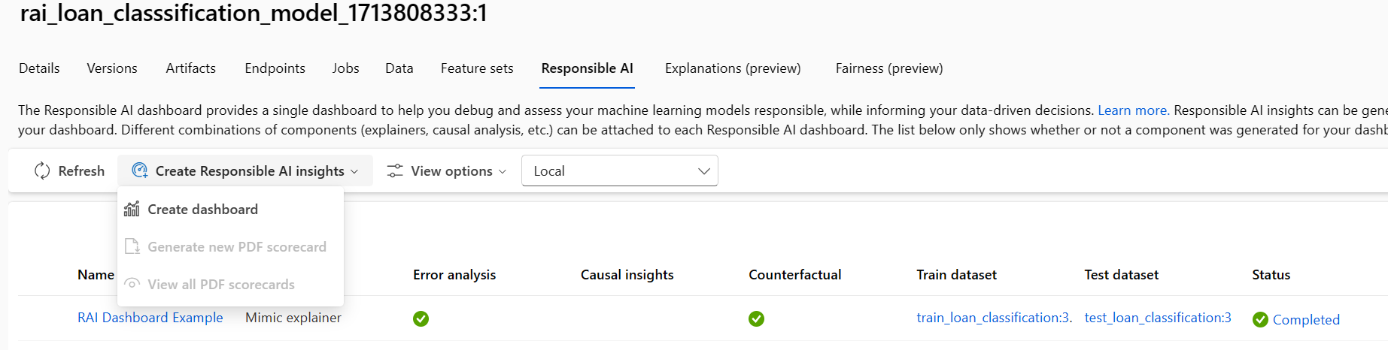
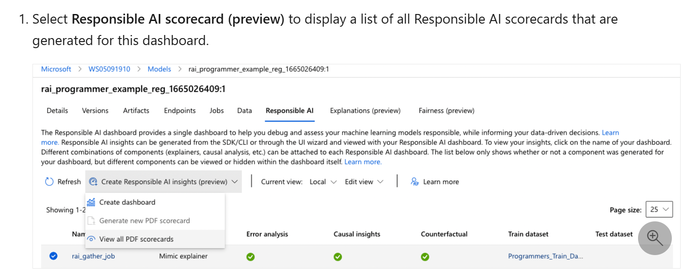



Scenario 1: RAI Scorecard (ML)
Q: Cannot generate scorecard?
Is it because Causal insights are missing?
Which is only available for regression?
Docs:

Slide 15
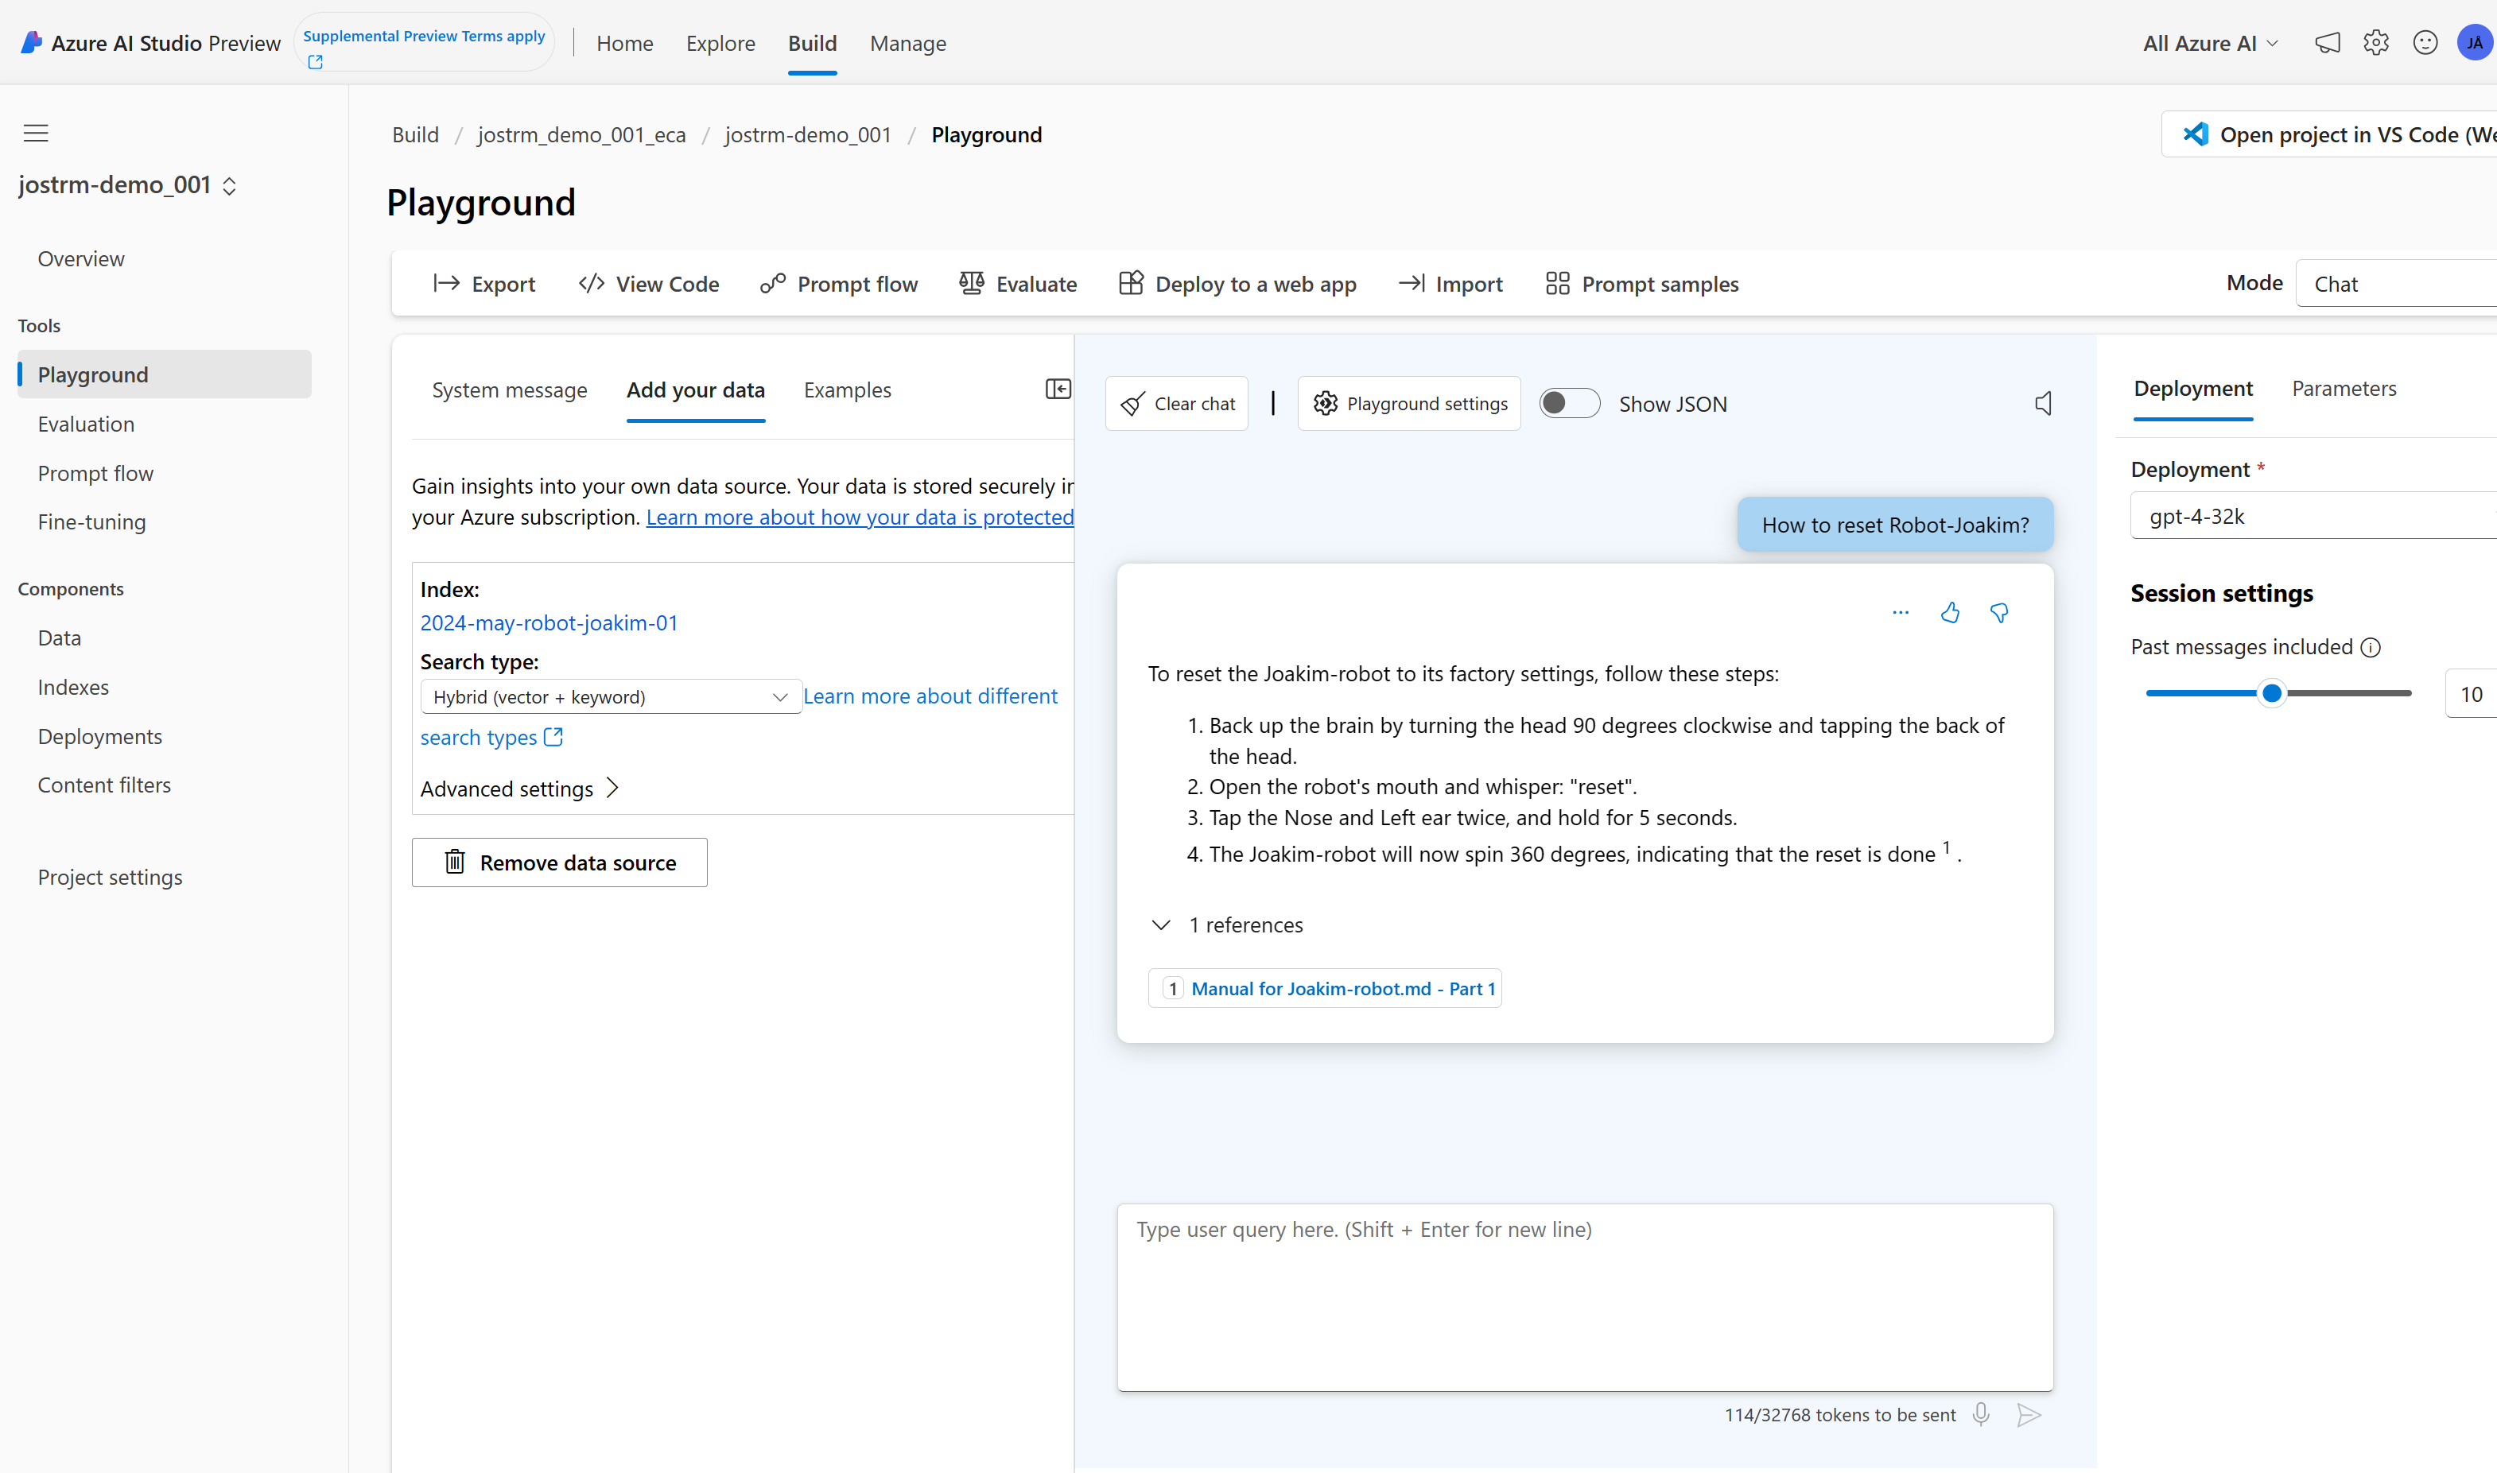
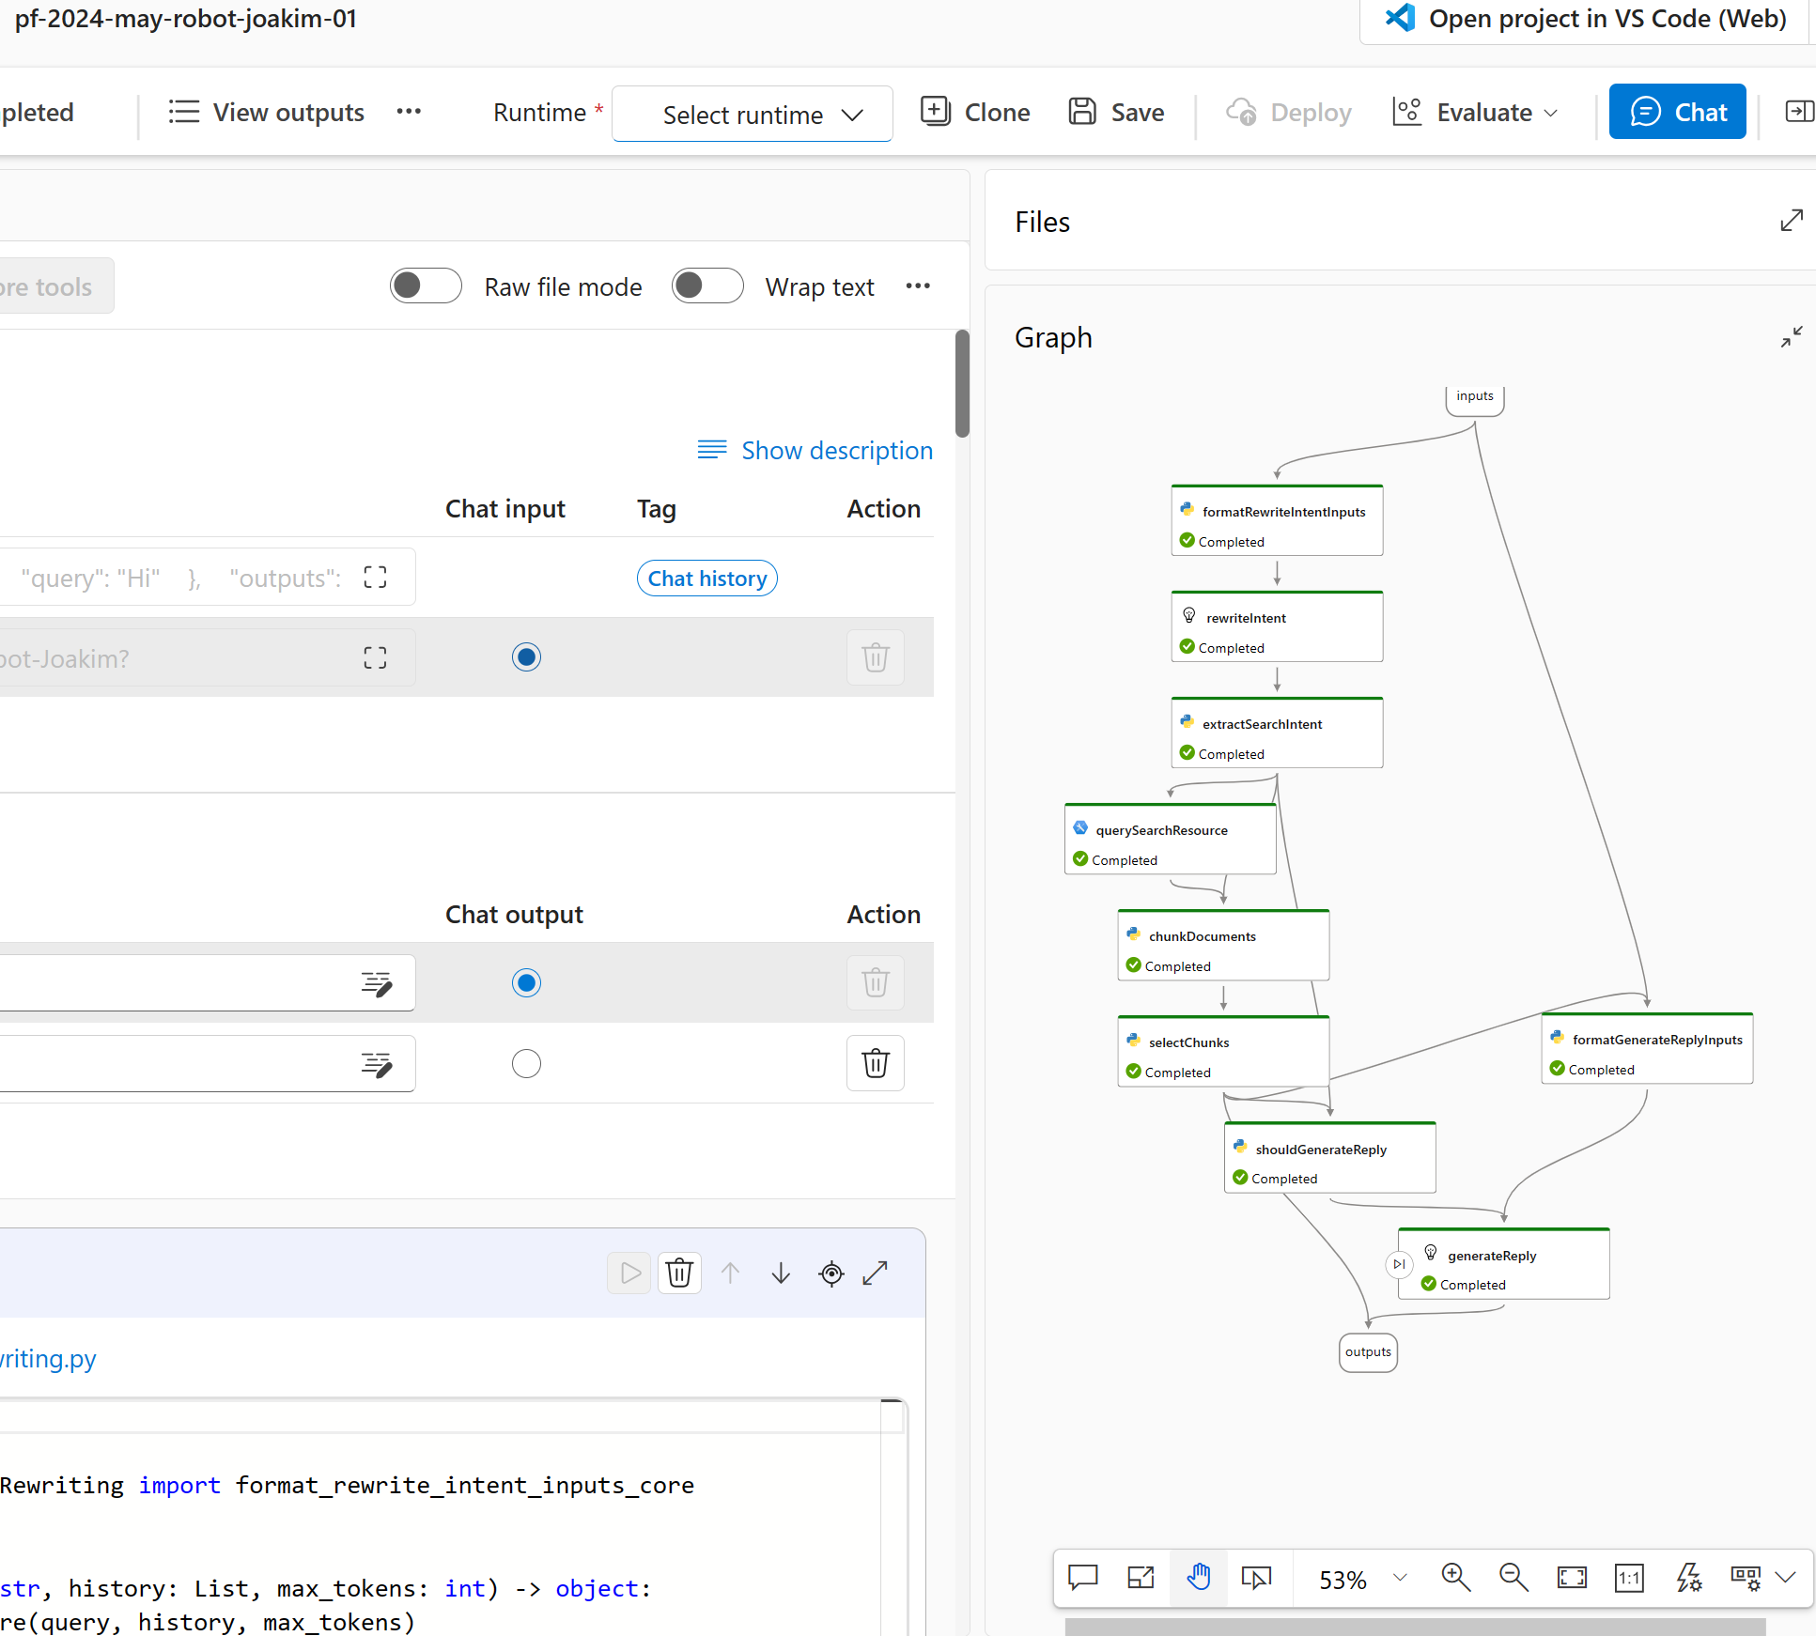
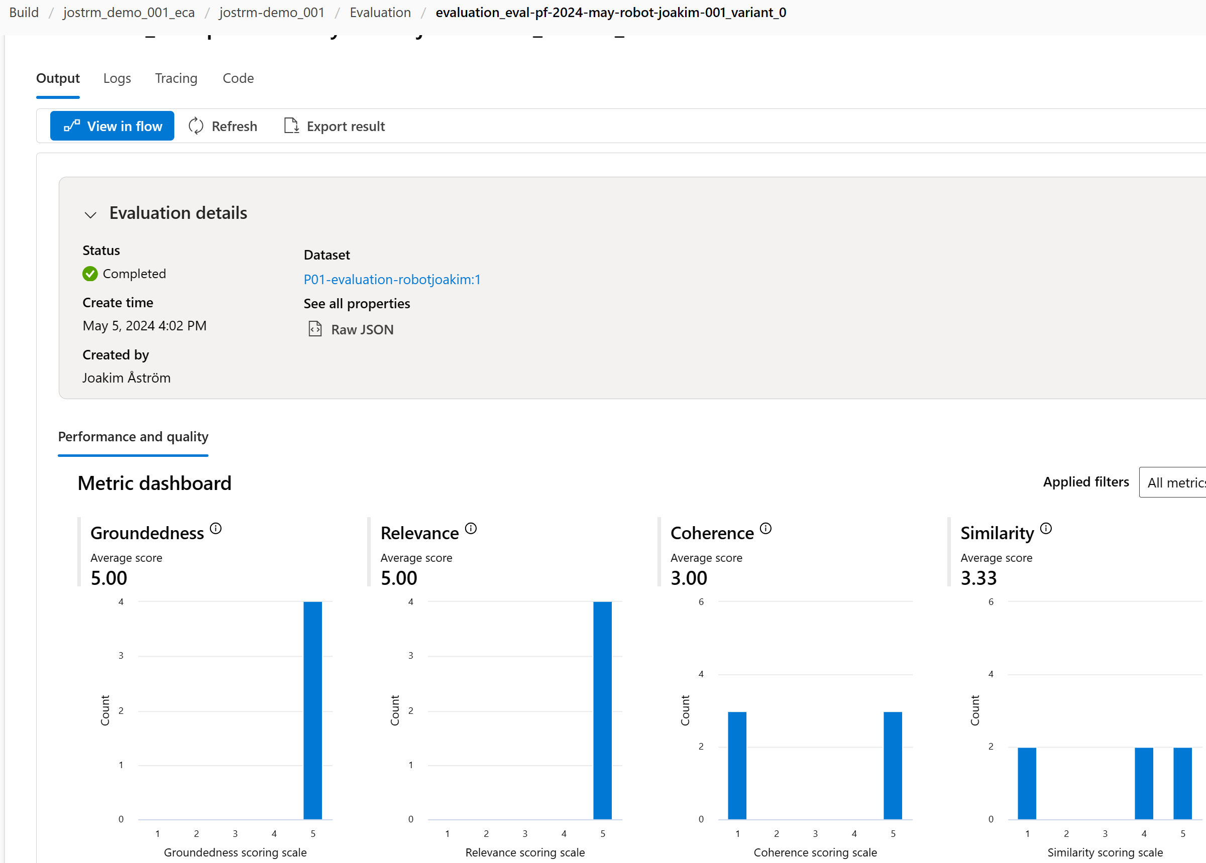

DEMO
AIStudio - Playground RAG
Scenario 2: GenAI evaluation
Create promptflow
+ Evaluation
Evaluate
Go to GITHUB repo (instructions, data for RAG, data for evaluation)
https://github.com/jostrm/azure-rai-hax
Scenario 2
2. Follow instructions, e.g. create RAG on GPT model, create a promptflow, adds evaluation on the promptflow
3. Use the dashboard. Push all buttons, write down answers for the Q’s in the GITHUB instructions. E.g. Q’s like
Q1) What values does the promptflow evaluation give you?
Q2) What values does the monitoring (live) give you?
https://github.com/jostrm/azure-rai-hax
Notes:
And Microsoft runs on trust. We are committed to security, privacy, and compliance across everything we do, and our approach to AI is no different.
Trust has been a fundamental promise we have built into the Microsoft Cloud since the very beginning.
Data is the fuel that powers AI technology – and you need to trust what your technology partners are doing with your data.
First, your data is your data. It is not our data. It is your data. That means it is yours to own and control. Your data to chose how you want to leverage and monetize.
Your data is not used to train or enrich the foundational AI models used by others without your permission, so you don’t have to worry about anyone other than your organization benefiting from AI that is trained on your data.
And your data and AI models are protected at every step by the most comprehensive enterprise compliance and security controls in the industry.

Slide 16
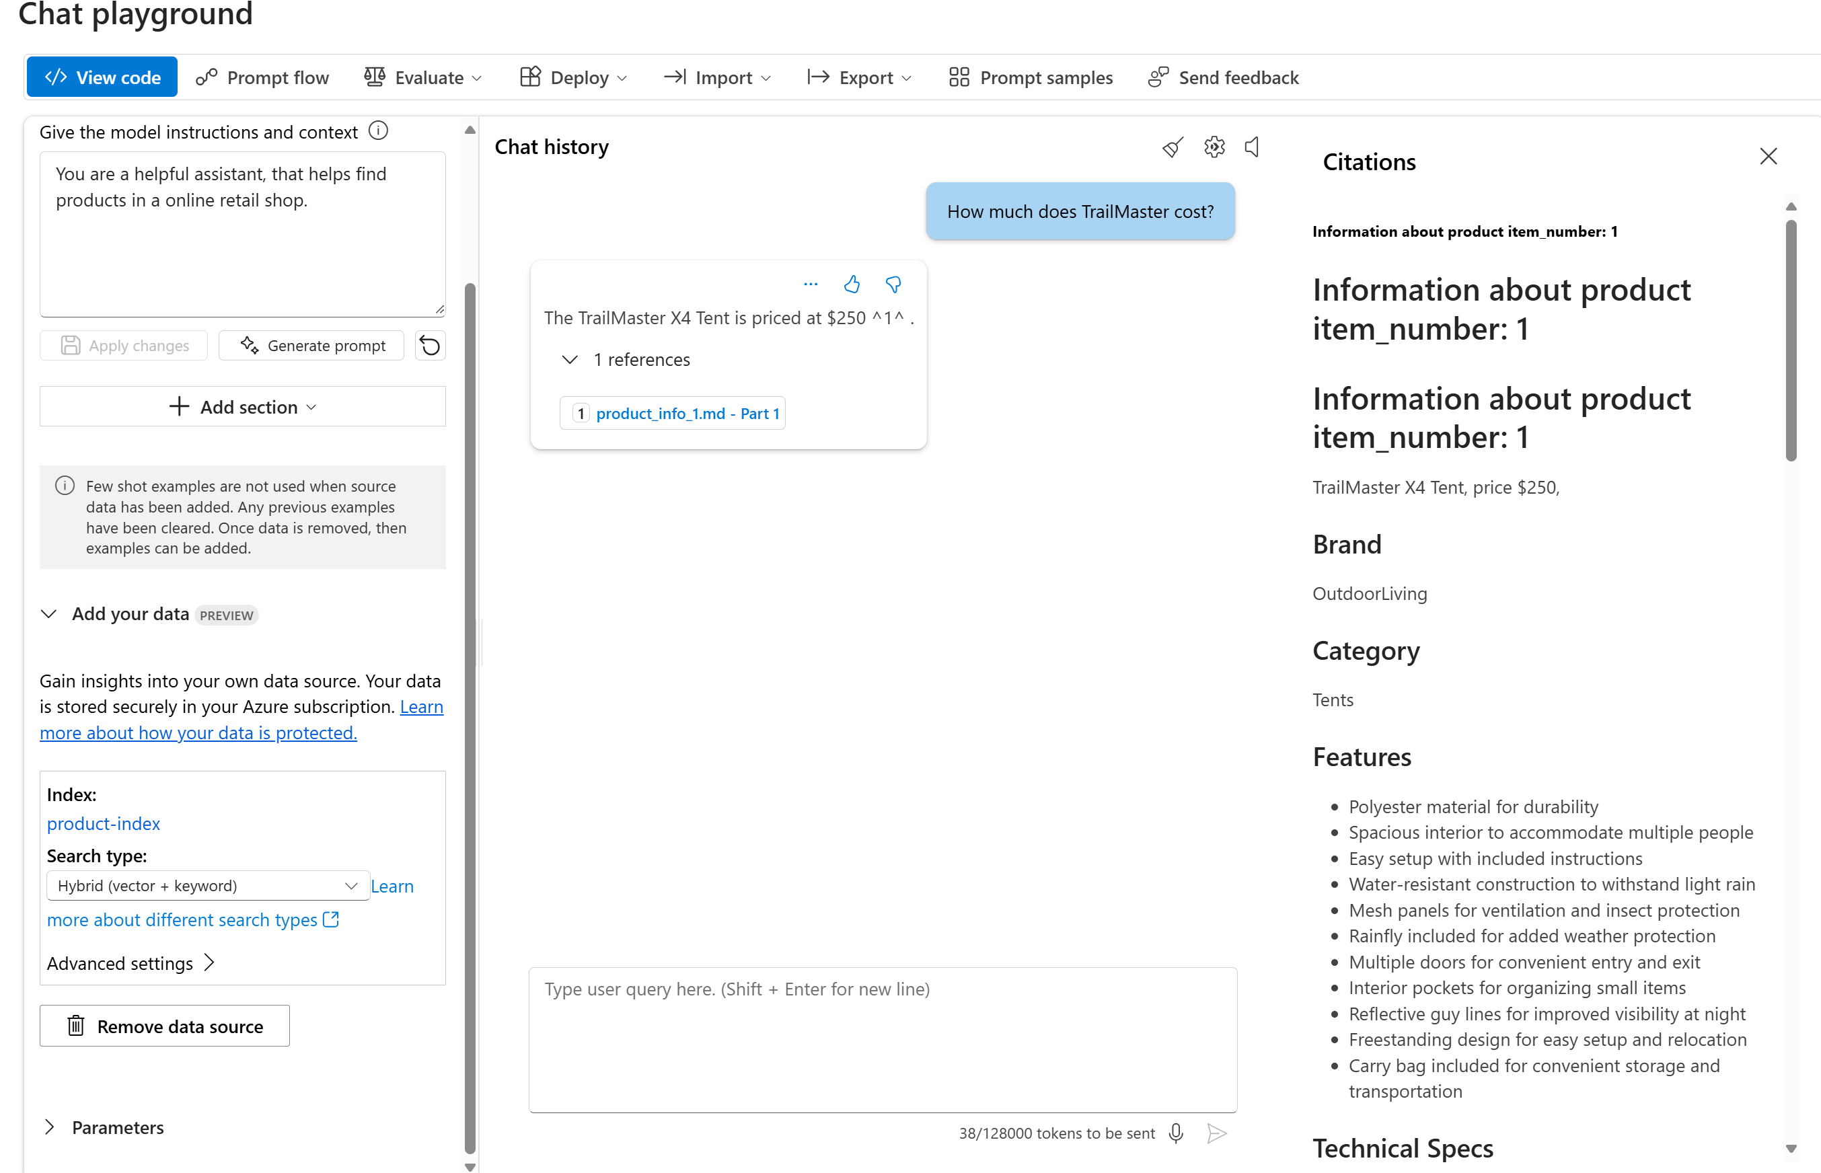
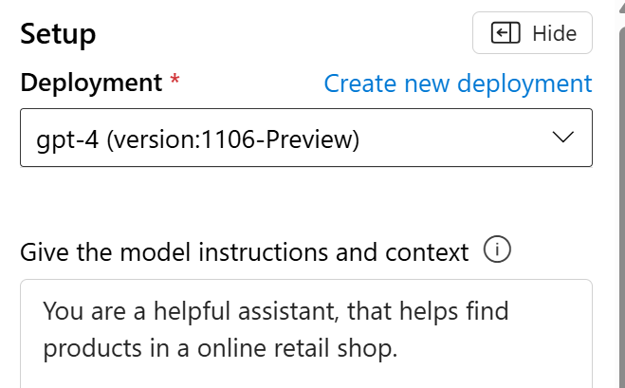
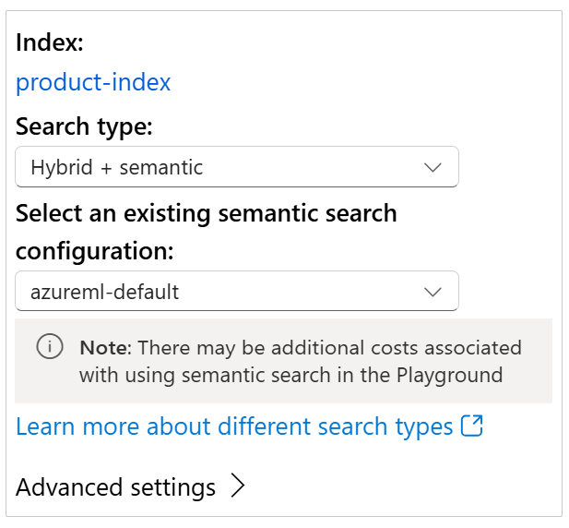
product-index
AI Studio
“Retail use case”
“On your data”

Slide 17
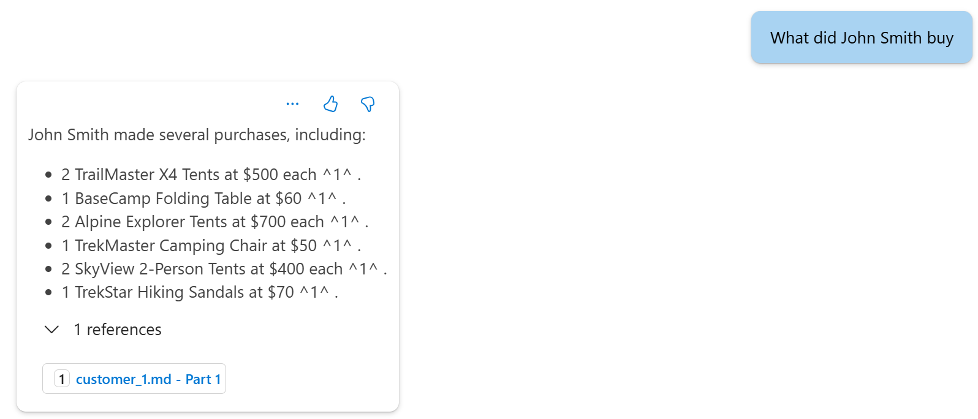
AI Studio
“Retail use case”
“On your data”
customer-index

Slide 18
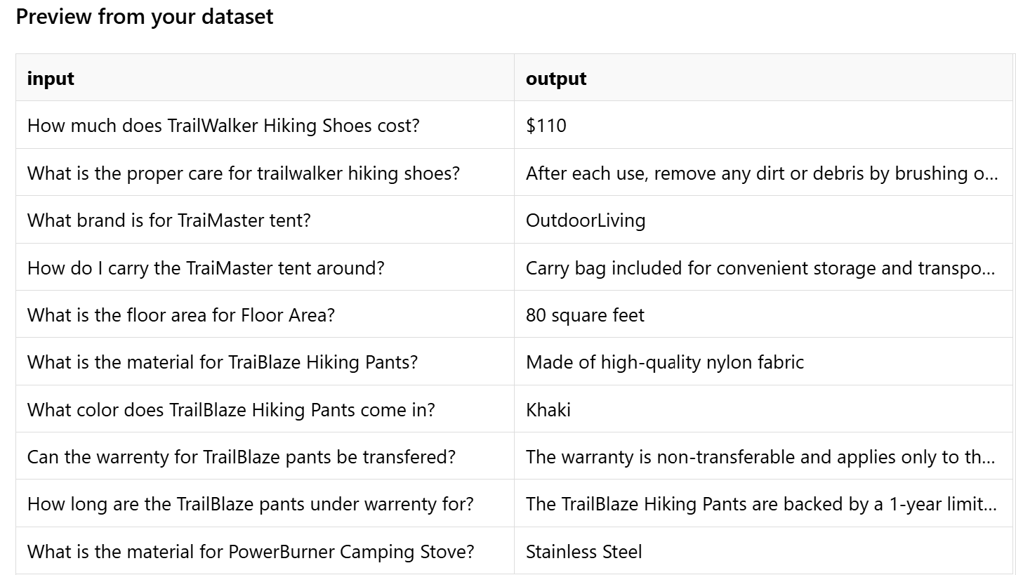
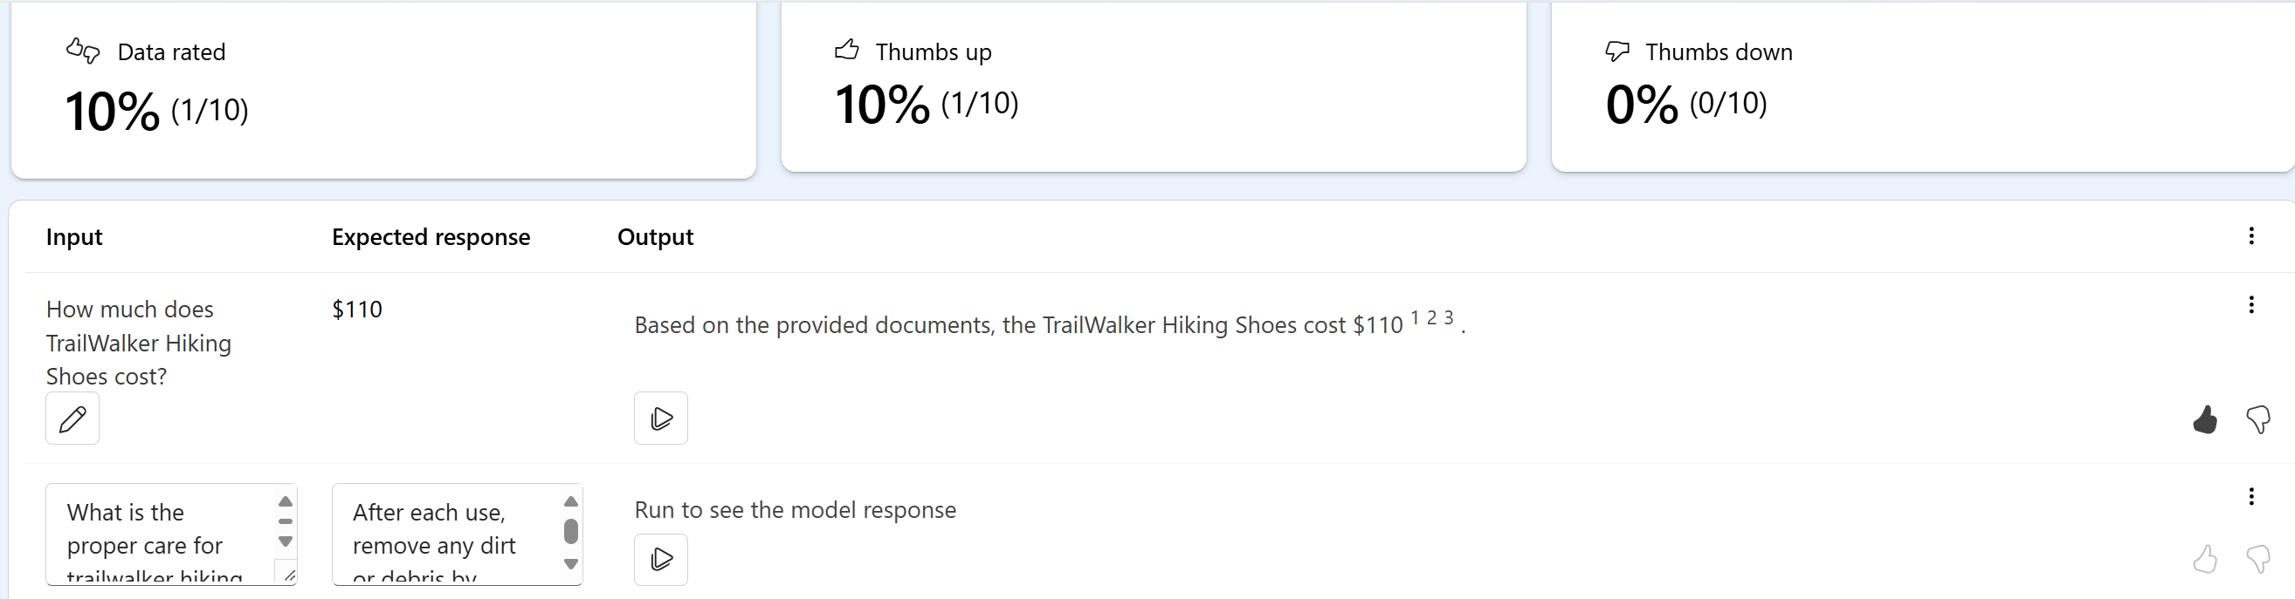
AI Studio
Manual
“import data”

Slide 19
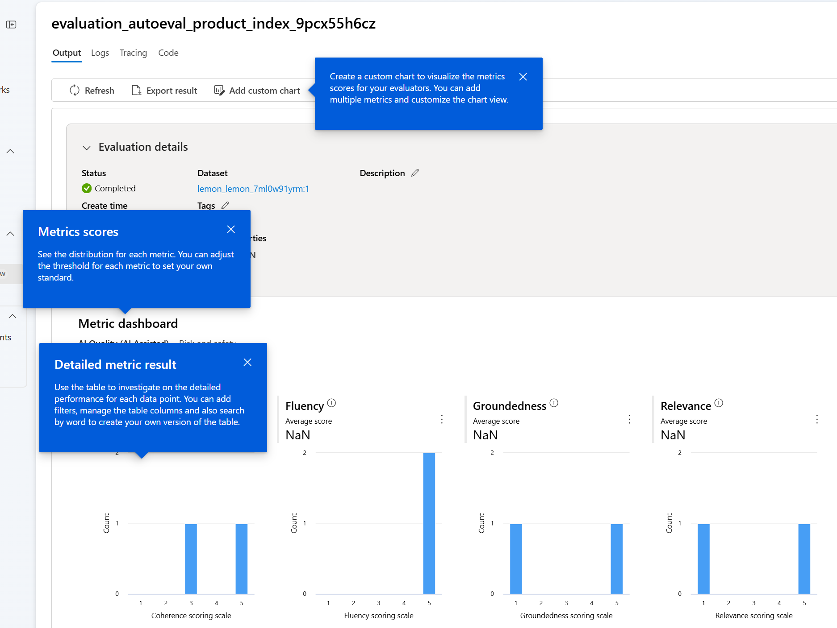
AI Studio
Auto evaluation
AI Quality (AI assisted)

Slide 20
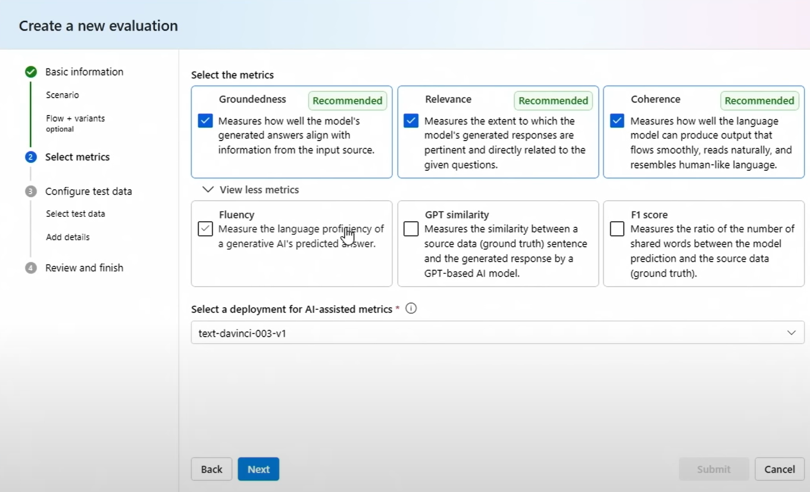
Which METRIC to choose?
LIVE a metric not needing your ground truth data

